Slide 1
PRESENTATION ON
SCHEDULING AND PAGE
REPLACEMENT
ALGORITHMS
BY
M N R SAI MAMATHA 4NI19CS062
MAHALAKSHMI S 4NI19CS065

Slide 2
WHAT IS SCHEDULING ?
When a computer is multi-programmed, it frequently has multiple processes or threads competing for the CPU at the same time. This situation occurs whenever two or more of them are simultaneously in the ready state. If only one CPU is available, a choice has to be made which process to run next. The part of the operating system that makes the choice is called the scheduler, and the algorithm it uses is called the scheduling algorithm.

Slide 3
FEW SCHEDULING ALGORITHMS ARE
First-Come, First-Served (FCFS) Scheduling
Shortest-Job-First (SJF) Scheduling
Priority Scheduling
Shortest Remaining Time First
Round Robin(RR) Scheduling
These algorithms are either non-preemptive or pre-emptive. Non-preemptive algorithms are designed so that once a process enters the running state, it cannot be pre-empted until it completes its allotted time, whereas the preemptive scheduling is based on priority where a scheduler may pre-empt a low priority running process anytime when a high priority process enters into a ready state.

Slide 4
SJF SCHEDULING ALGORITHM
Shortest job first (SJF) also known as Shortest job next (SJN), is a scheduling algorithm that selects for execution the waiting process with the smallest execution time. SJF is a non-pre-emptive algorithm. Shortest Remaining Time First is a preemptive variant of SJF.
ADVANTAGES
• Maximum throughput. Throughput means total number of processes executed per unit time. Shortest job first scheduling algorithm selects the waiting process with the smallest execution time. Thus, in SJF, shortest jobs are executed first making the CPU utilization maximum. So, maximum number of tasks are completed.
• Minimum waiting and turn around time as compared with other scheduling algorithms

Slide 5
DISADVANTAGES
• It may cause starvation if shorter process keeps coming.
ALGORITHM
1. Sort all the processes according to their arrival time.
2. Select the process with minimum arrival time as well as minimum burst time.
3. After completion of the process, select from the ready queue the process which has the minimum burst time.
4. If processes have same burst time length then FCFS ( First come First Serve ) scheduling algorithm used.
5. Repeat above processes until all processes have finished their execution.
Completion Time: Time at which process completes its execution.
Turn Around Time: Time Difference between completion time and arrival time. Turn Around Time = Completion Time – Arrival Time
Waiting Time(W.T): Time Difference between turn around time and burst time. Waiting Time = Turn Around Time – Burst Time

Slide 6
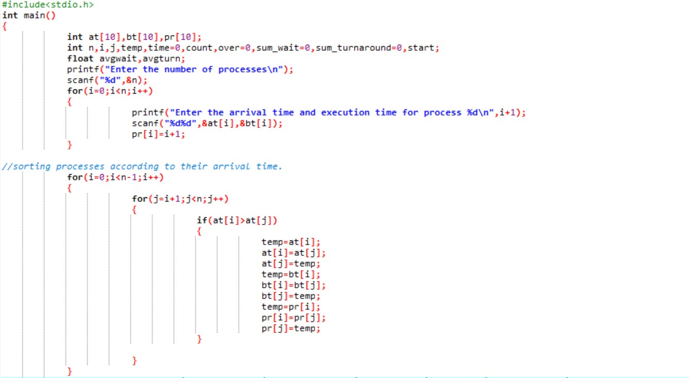
CODE

Slide 7
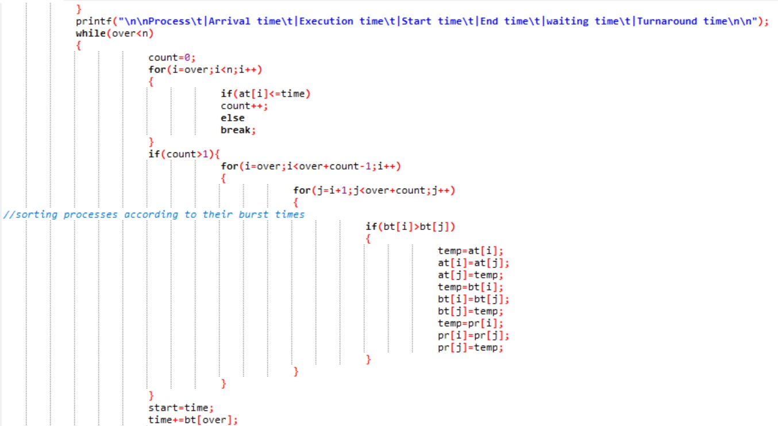

Slide 8
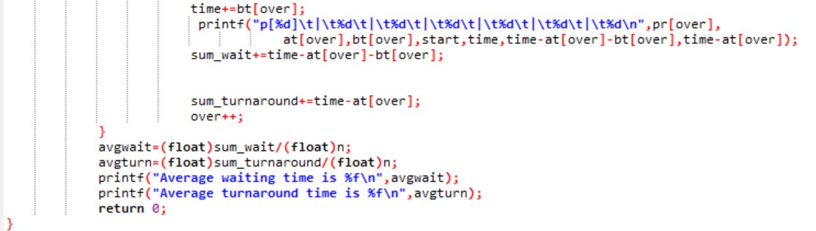

Slide 9
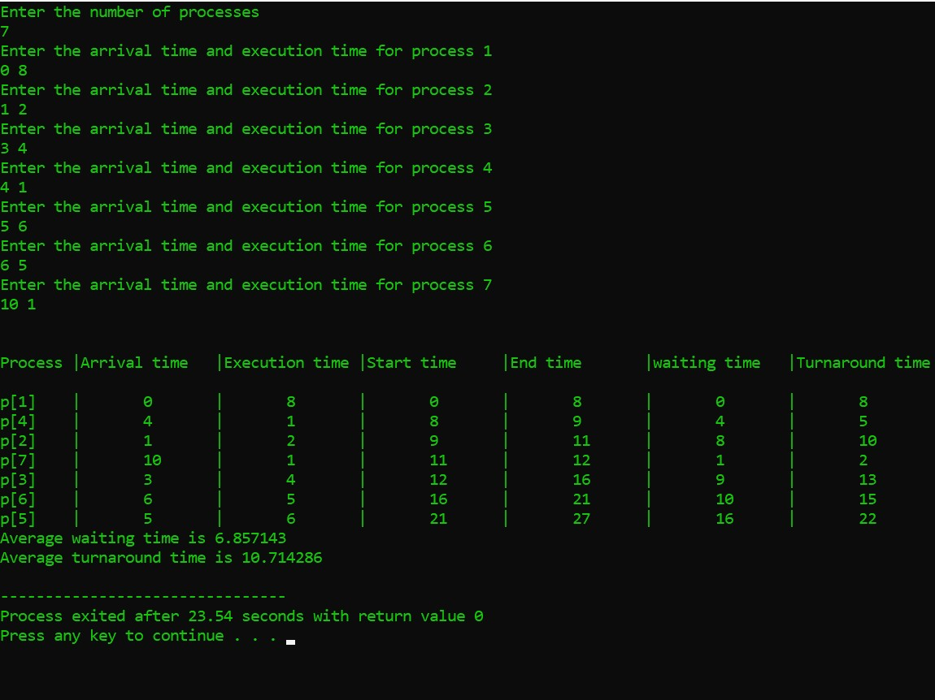
SAMPLE OUTPUT

Slide 10
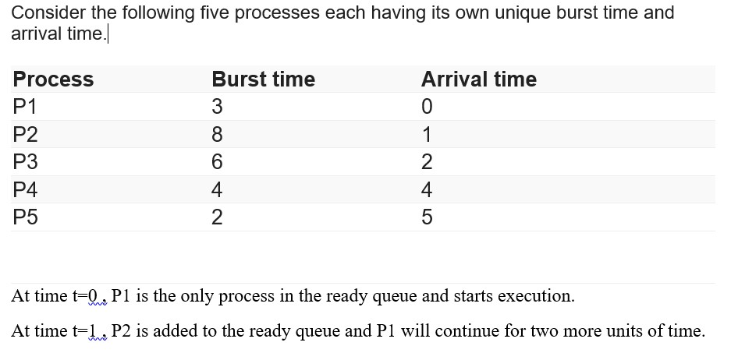
EXAMPLE

Slide 11
At time t=2 , P3 is added to the ready queue and P1 will continue execution for one more unit of time.
At time t=3, P1 completes execution.The burst time of P2 and P3 is compared.P3 is allocated with the cpu since P3 has less burst time compared to P2.
At time t=4, P4 is added to the ready queue.P3 will continue execution.
At time t=5,P5 is added to the ready queue.P3 will continue execution.
At time t=9,P3 completes execution.Burst time of P2,P4,P5 is compared . P5 is executed as it has the lowest burst time.
At time t=11,P5 completes execution.Burst time of P2 and P4 is compared.P4 is executed as it has less burst time.
At time t=15,P4 completes execution and P2 starts execution.
At time t=23,P2 completes execution.

Slide 12
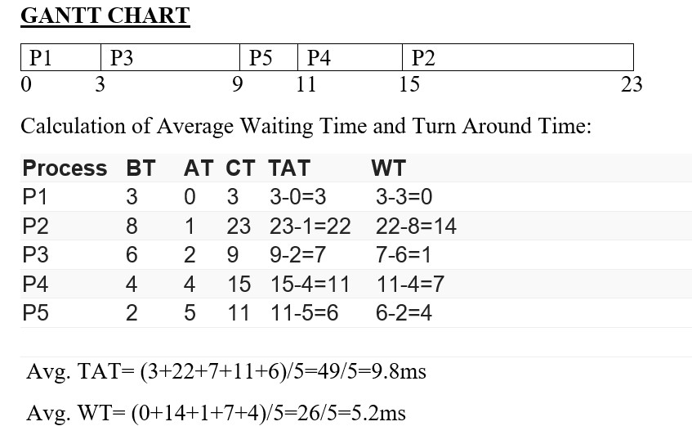

Slide 13
PAGE REPLACEMENT ALGORITHM
The page replacement algorithm decides which memory page is to be replaced.
Page Fault – A page fault occurs when a page requested by a program is not present in the main memory.
The effectiveness of a page replacement algorithm is measured with the number of page fault it generates. The more effective the page replacement algorithm is, the less the number of page faults generated by the algorithm.

Slide 14
FIFO PAGE REPLACEMENT ALGORITHM
First-in, first-out (FIFO) algorithm has a simple approach to this problem. We keep track of all the pages by using a queue in the main memory. As soon as a page comes in, we’ll put it in the queue and continue. In this way, the oldest page would always be in the first place of the queue.
Now when a new page comes in and there is no space in the memory, we remove the first page in the queue, which is also the oldest one. It repeats this process until the operating system has page flow in the system.
ADVANATAGES
Easy to understand and implement.
DISADVANTAGES
The process effectiveness is low.
When we increase the number of frames while using FIFO, we are giving more memory to processes. So, page fault should decrease, but here the page faults are increasing. This problem is called as Belady’s Anomaly.
Every frame needs to be taken account off.

Slide 15
ALGORITHM
Step 1. Start to traverse the pages.
Step 2. If the memory holds fewer pages, then the capacity else goes to step 5.
Step 3. Push pages in the queue one at a time until the queue reaches its maximum capacity or all page requests are fulfilled.
Step 4. If the current page is present in the memory, do nothing.
Step 5. Else, pop the topmost page from the queue as it was inserted first.
Step 6. Replace the topmost page with the current page from the string.
Step 7. Increment the page faults.
Step 8. Stop

Slide 16
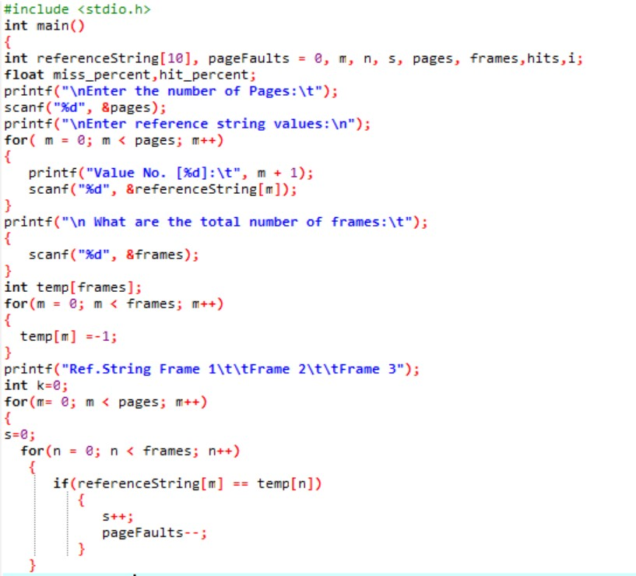
CODE

Slide 17
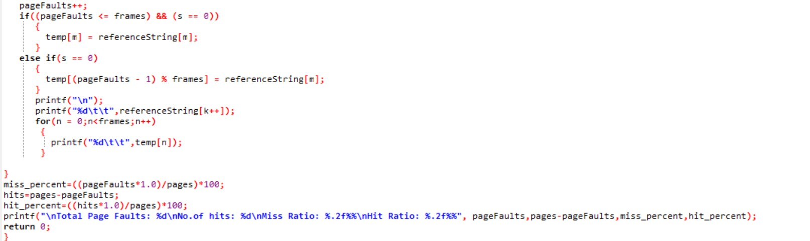

Slide 18
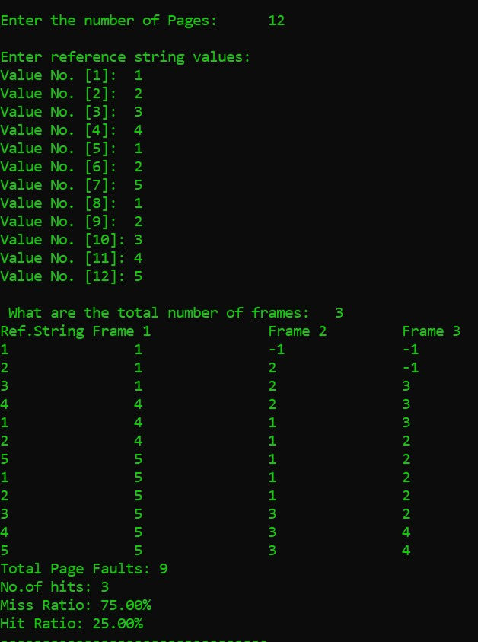
SAMPLE OUTPUT

Slide 19
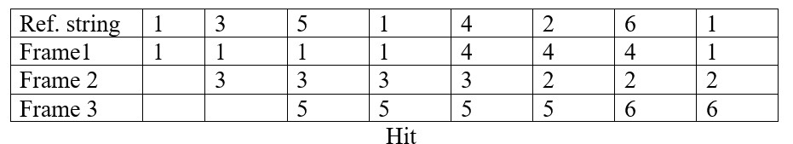
EXAMPLE
Consider a reference string 1 3 5 1 4 2 6 1
No.of frames = 3
Page Fault = 7
No.of Hits = 1
Hit ratio = 1/8
=12.5%
Miss ratio = 7/8
=87.5%

Slide 20
THANK YOU

